Slide 1
Ruby
Ruby Programming Language

Slide 2
Ruby Programming Language
Interpreted
High-level
Dynamically typed
Imperative
Multi-paradigm
Procedural
Functional
Object-oriented

Slide 3
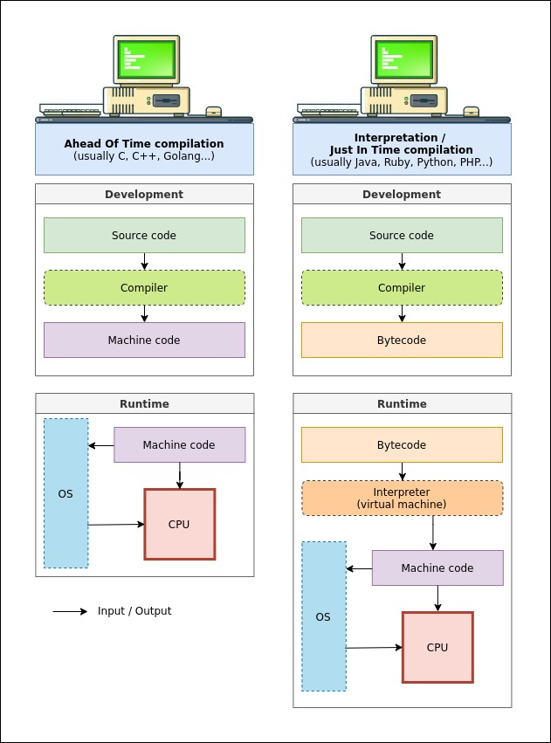
Interpreted vs Compiled
Translate source code into some efficient intermediate representation or object code and immediately execute that
Translate source code from a high-level programming language to a low-level programming language that can be executed

Slide 4
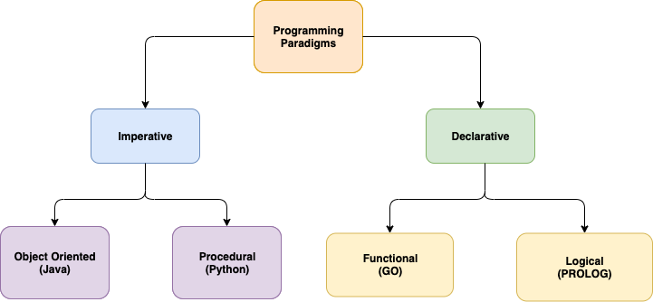
Programming Paradigms

Slide 5
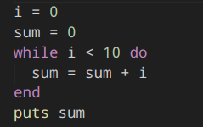
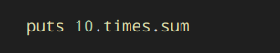
Imperative vs Declarative
Everything is an expression
Instructions
The system is stupid, you are smart
Express logic statements
Outcome
The system is smart, you don’t care

Slide 6
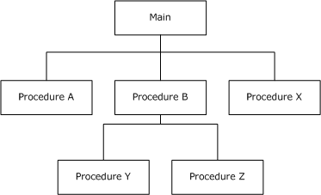
Procedural Programming

Slide 7
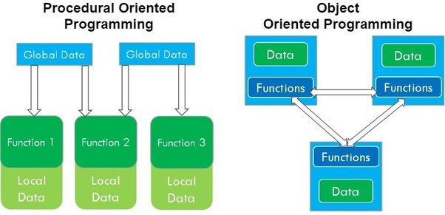
Object-Oriented Programming
Abstraction
Class
Object
Interface
Polymorphism
Inheritance
Encapsulation

Slide 8
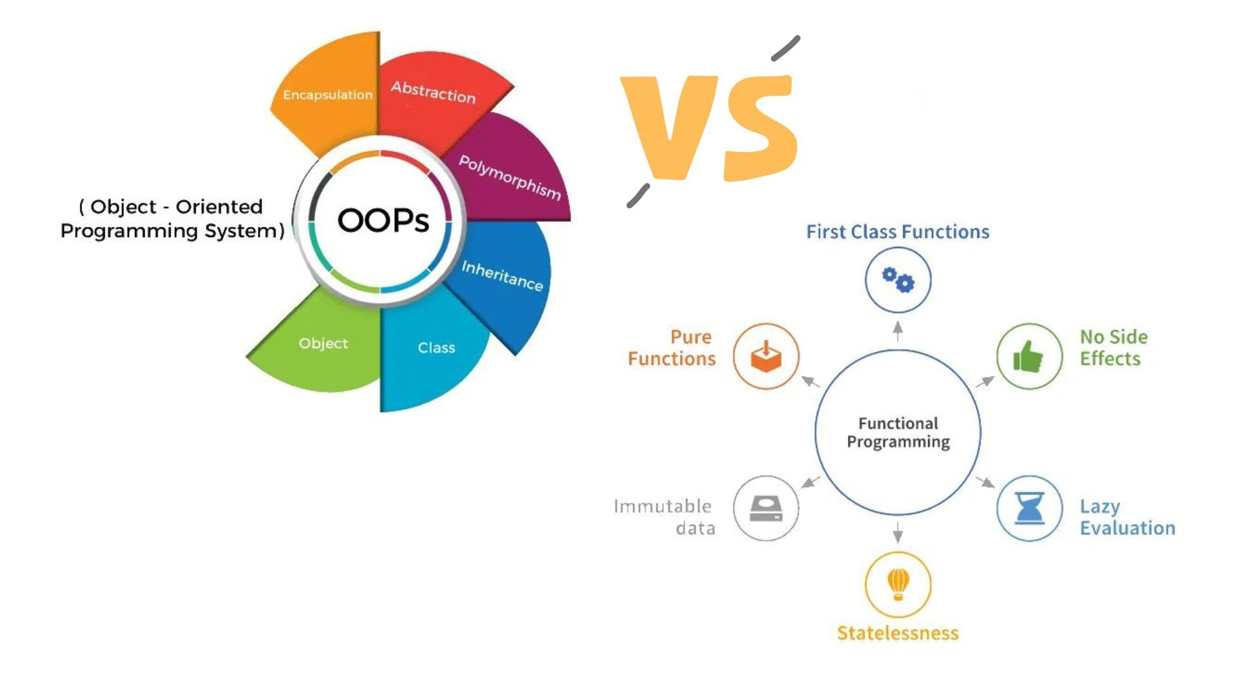
Functional Programming
Function as first-class citizen
Higher-order function
Pure function
Immutable states
Deterministic

Slide 9
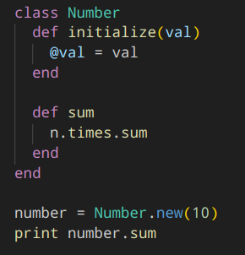
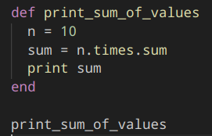
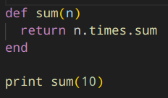
Procedure vs Function vs Method
Procedure DOES something
Function computes the result by the given arguments
Method is associated with an object

Slide 10
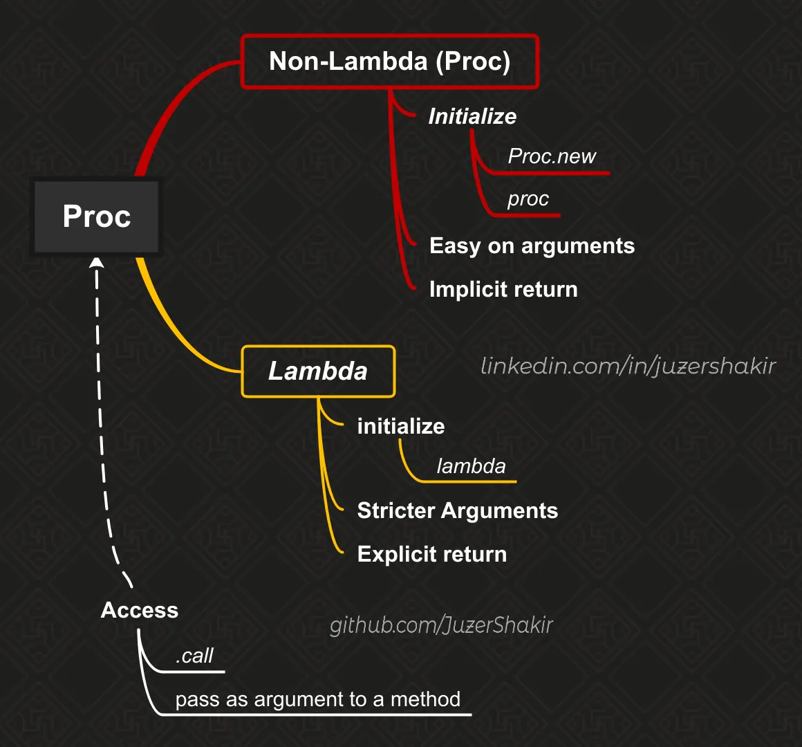
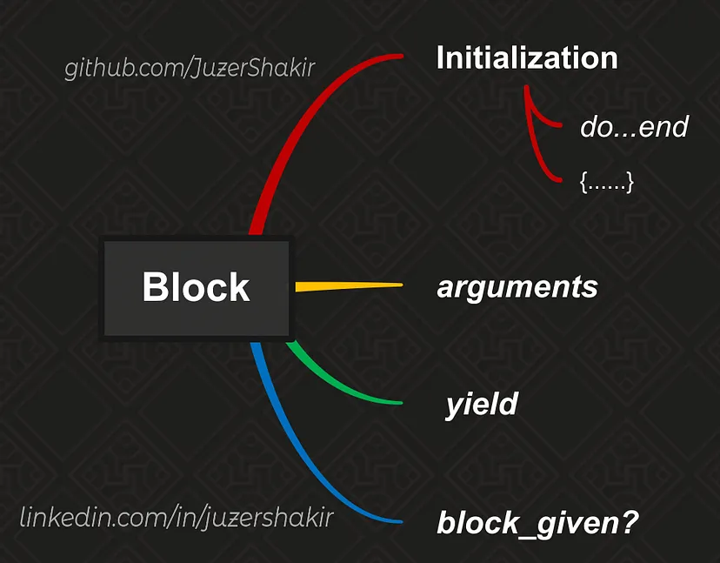
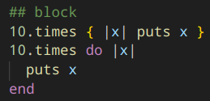
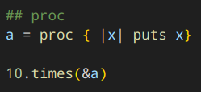
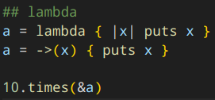
Block vs Proc vs Lambda

Slide 11
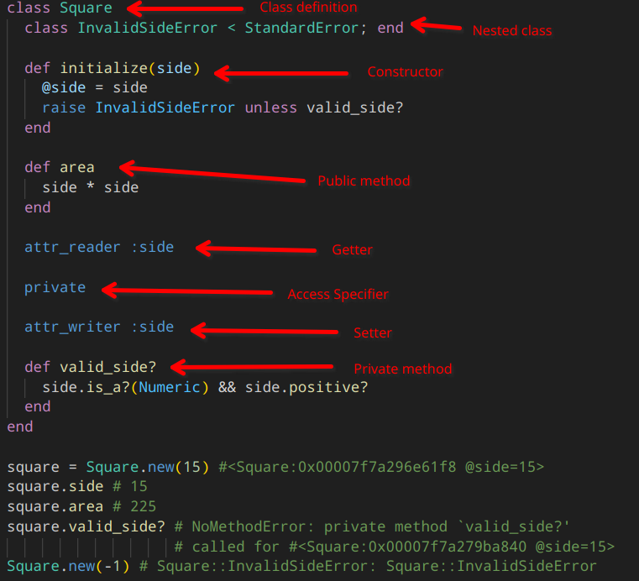
Class
Constructor
Destructor
Method
Getter/Setter
Access Specifier
Instance Variable
Class Variable
Method Naming

Slide 12
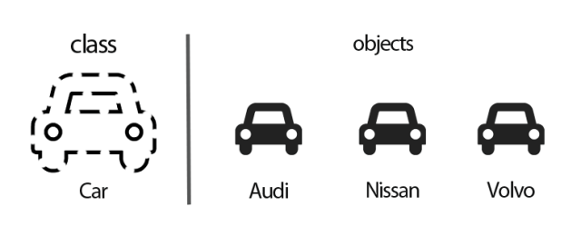
Object aka Instance
In ruby everything is object except:
Code Blocks
Methods
Operators

Slide 13
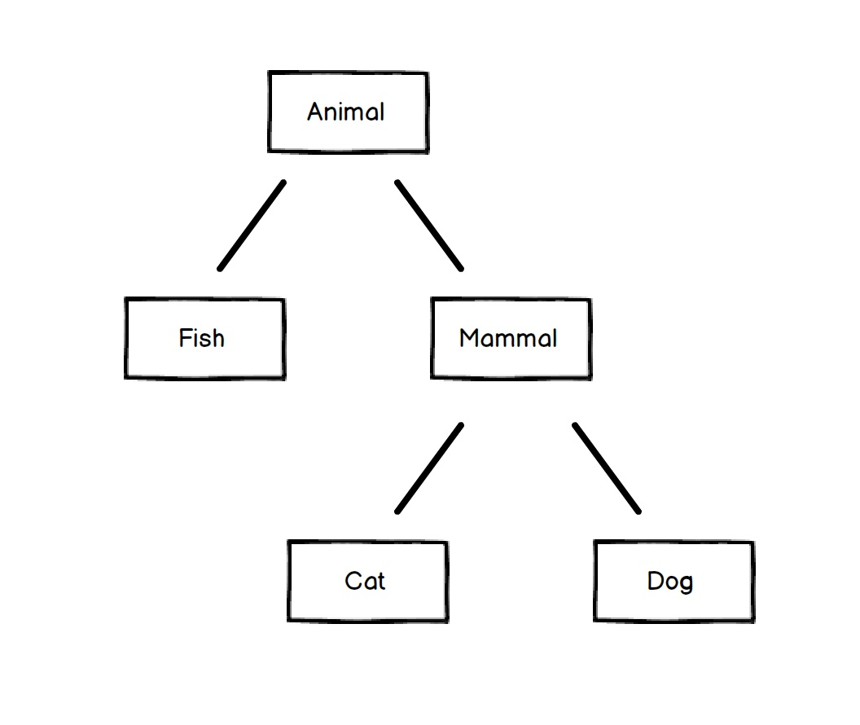
Class Inheritance
Inherit methods and variables
Call super methods
Override parent methods

Slide 14
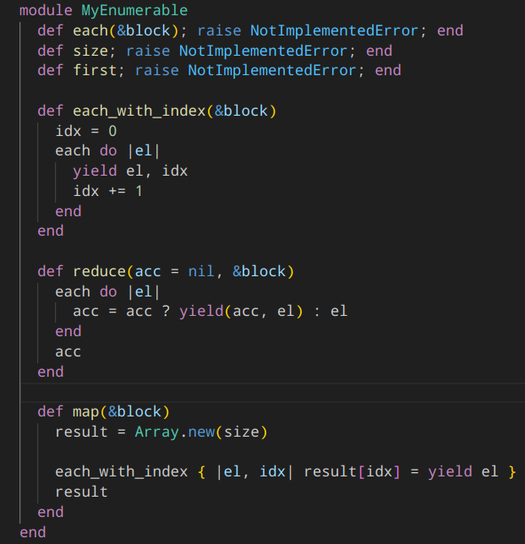
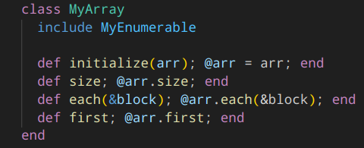
Module
No instance, similar to interface
Mixin pattern
Can be included, prepended and extended

Slide 15
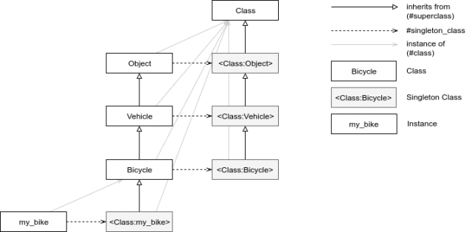
Singleton Class
Singleton pattern implementation
Copy of a class for each instance
Class also has Singleton Class!
Class methods are instance methods of Singleton Class

Slide 16
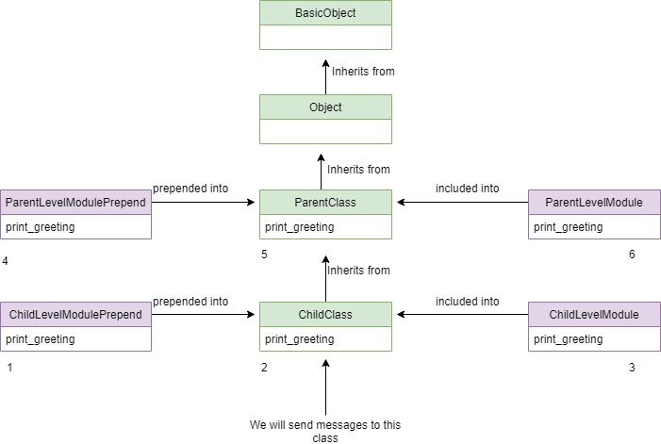
Method Lookup
method_missing
instance_eval
class_eval
send
public_send
define_method

Slide 17
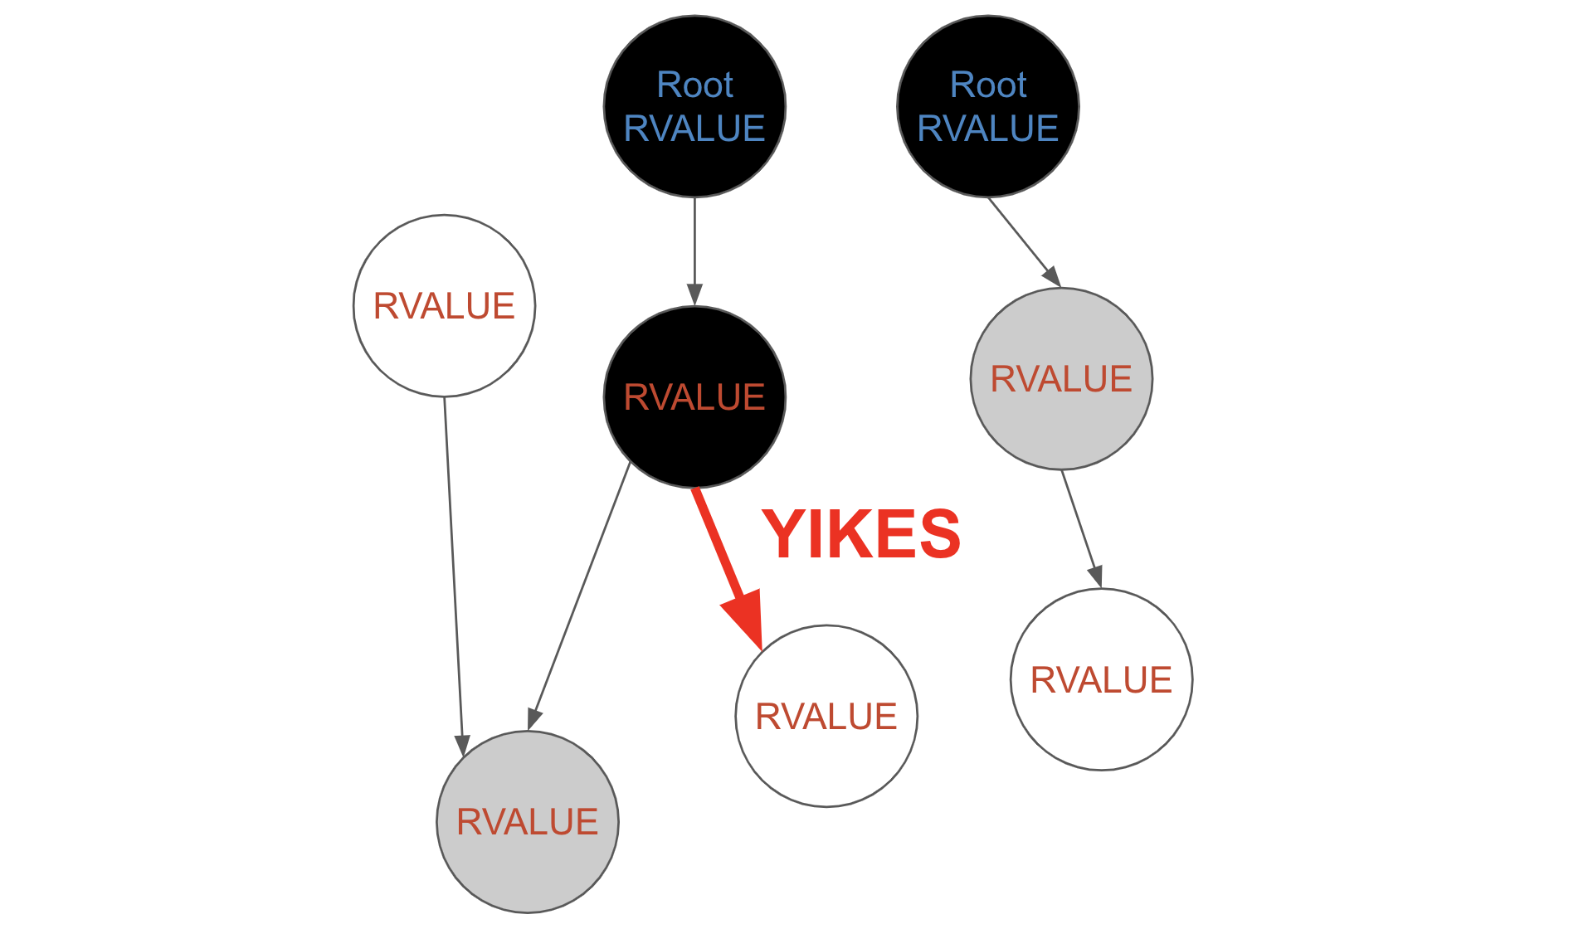
Garbage Collection
Allocation phase
Object creation
Memory management
Page allocation
Heap expansion
Garbage collection trigger
Tri-Color marking
Sweeping
Generations
Stops execution

Slide 18
Thread vs Process

Slide 19
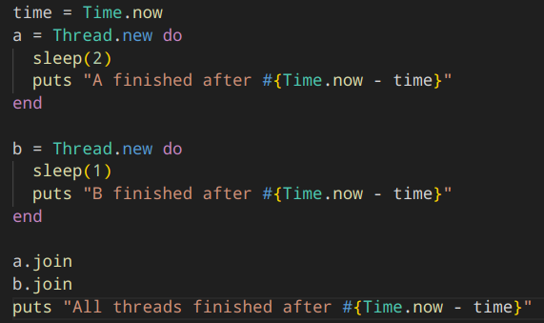
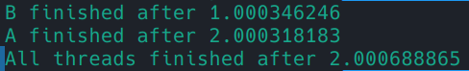
Ruby Thread
Managed independently
Scheduled by VM
“Sleeps” on I/O operations

Slide 20
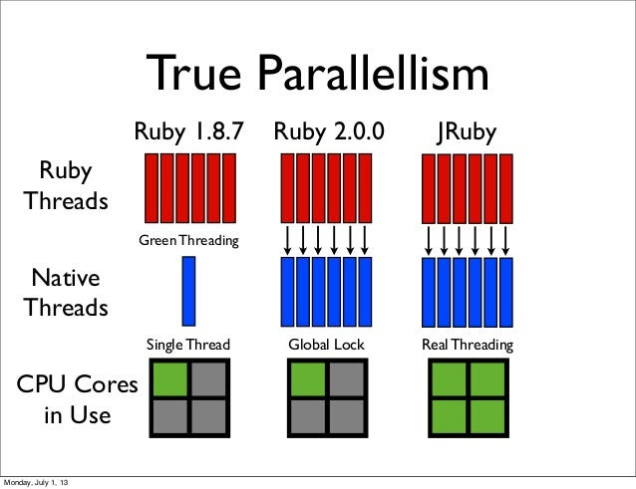
Parallelism and Concurrency
Thread
Fiber
Ractor (Ruby 3.0)
Process

Slide 21
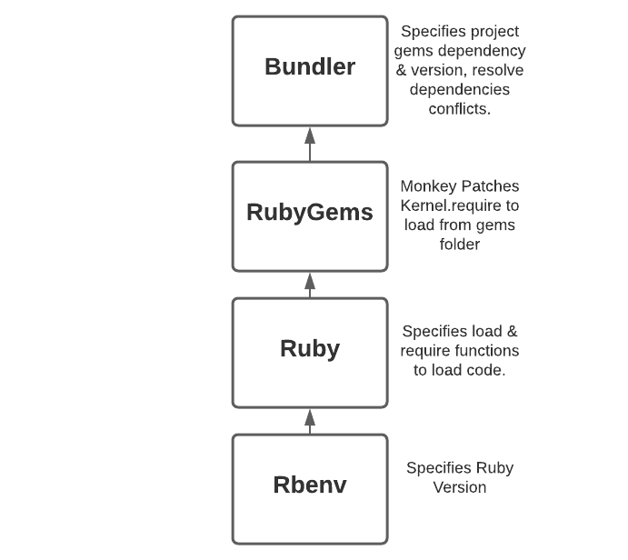
Gem and Bundler
Ruby can import files
Prebuilt modules are called gems
Bundler manages gems for a project

Slide 22

Thank you for your attention!

